Slide 1
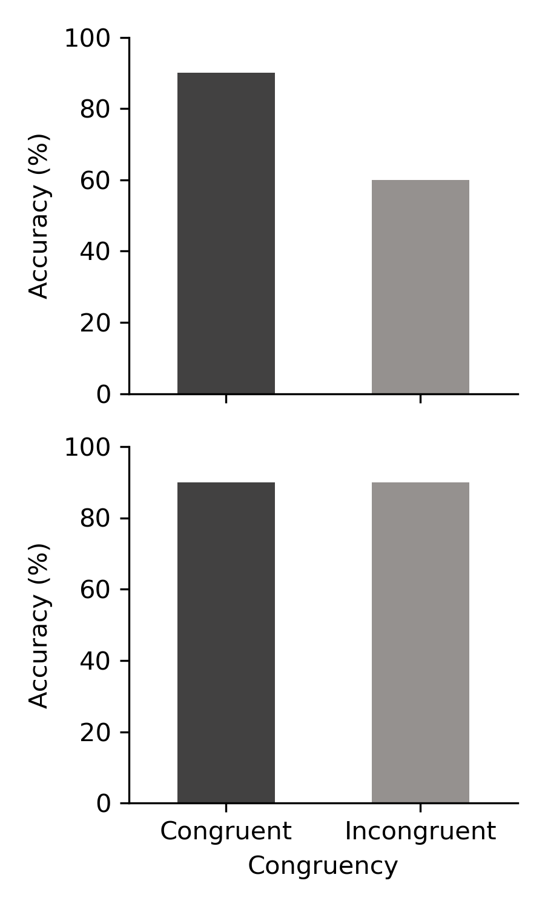
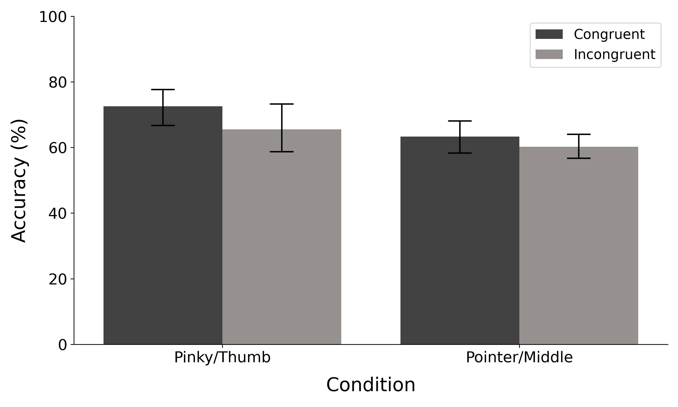
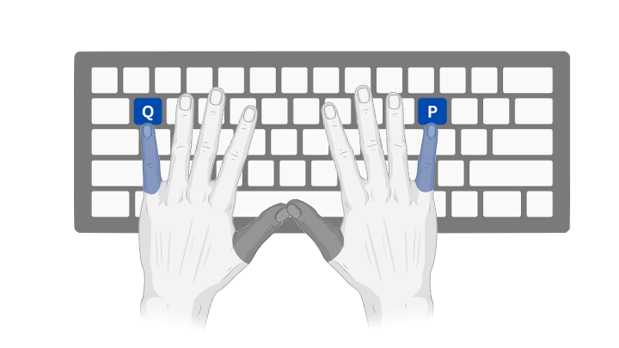


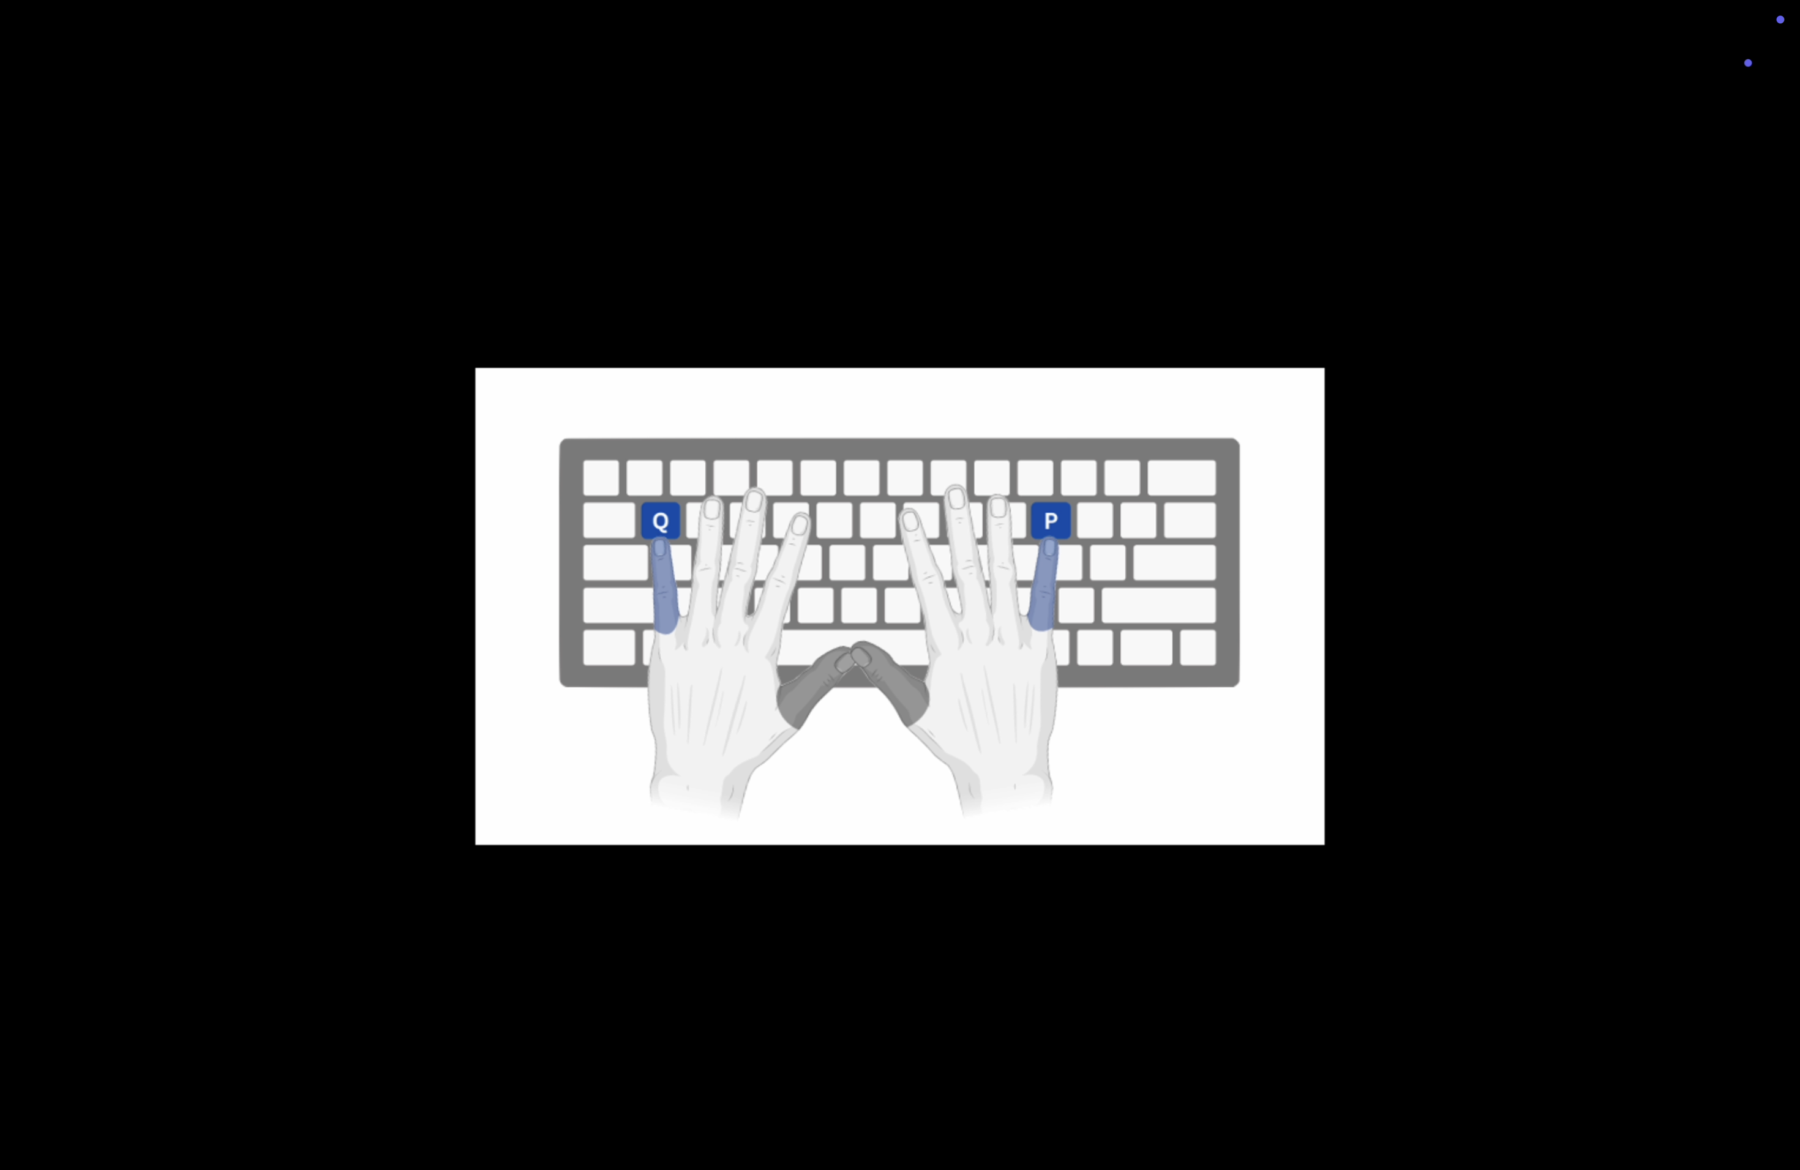
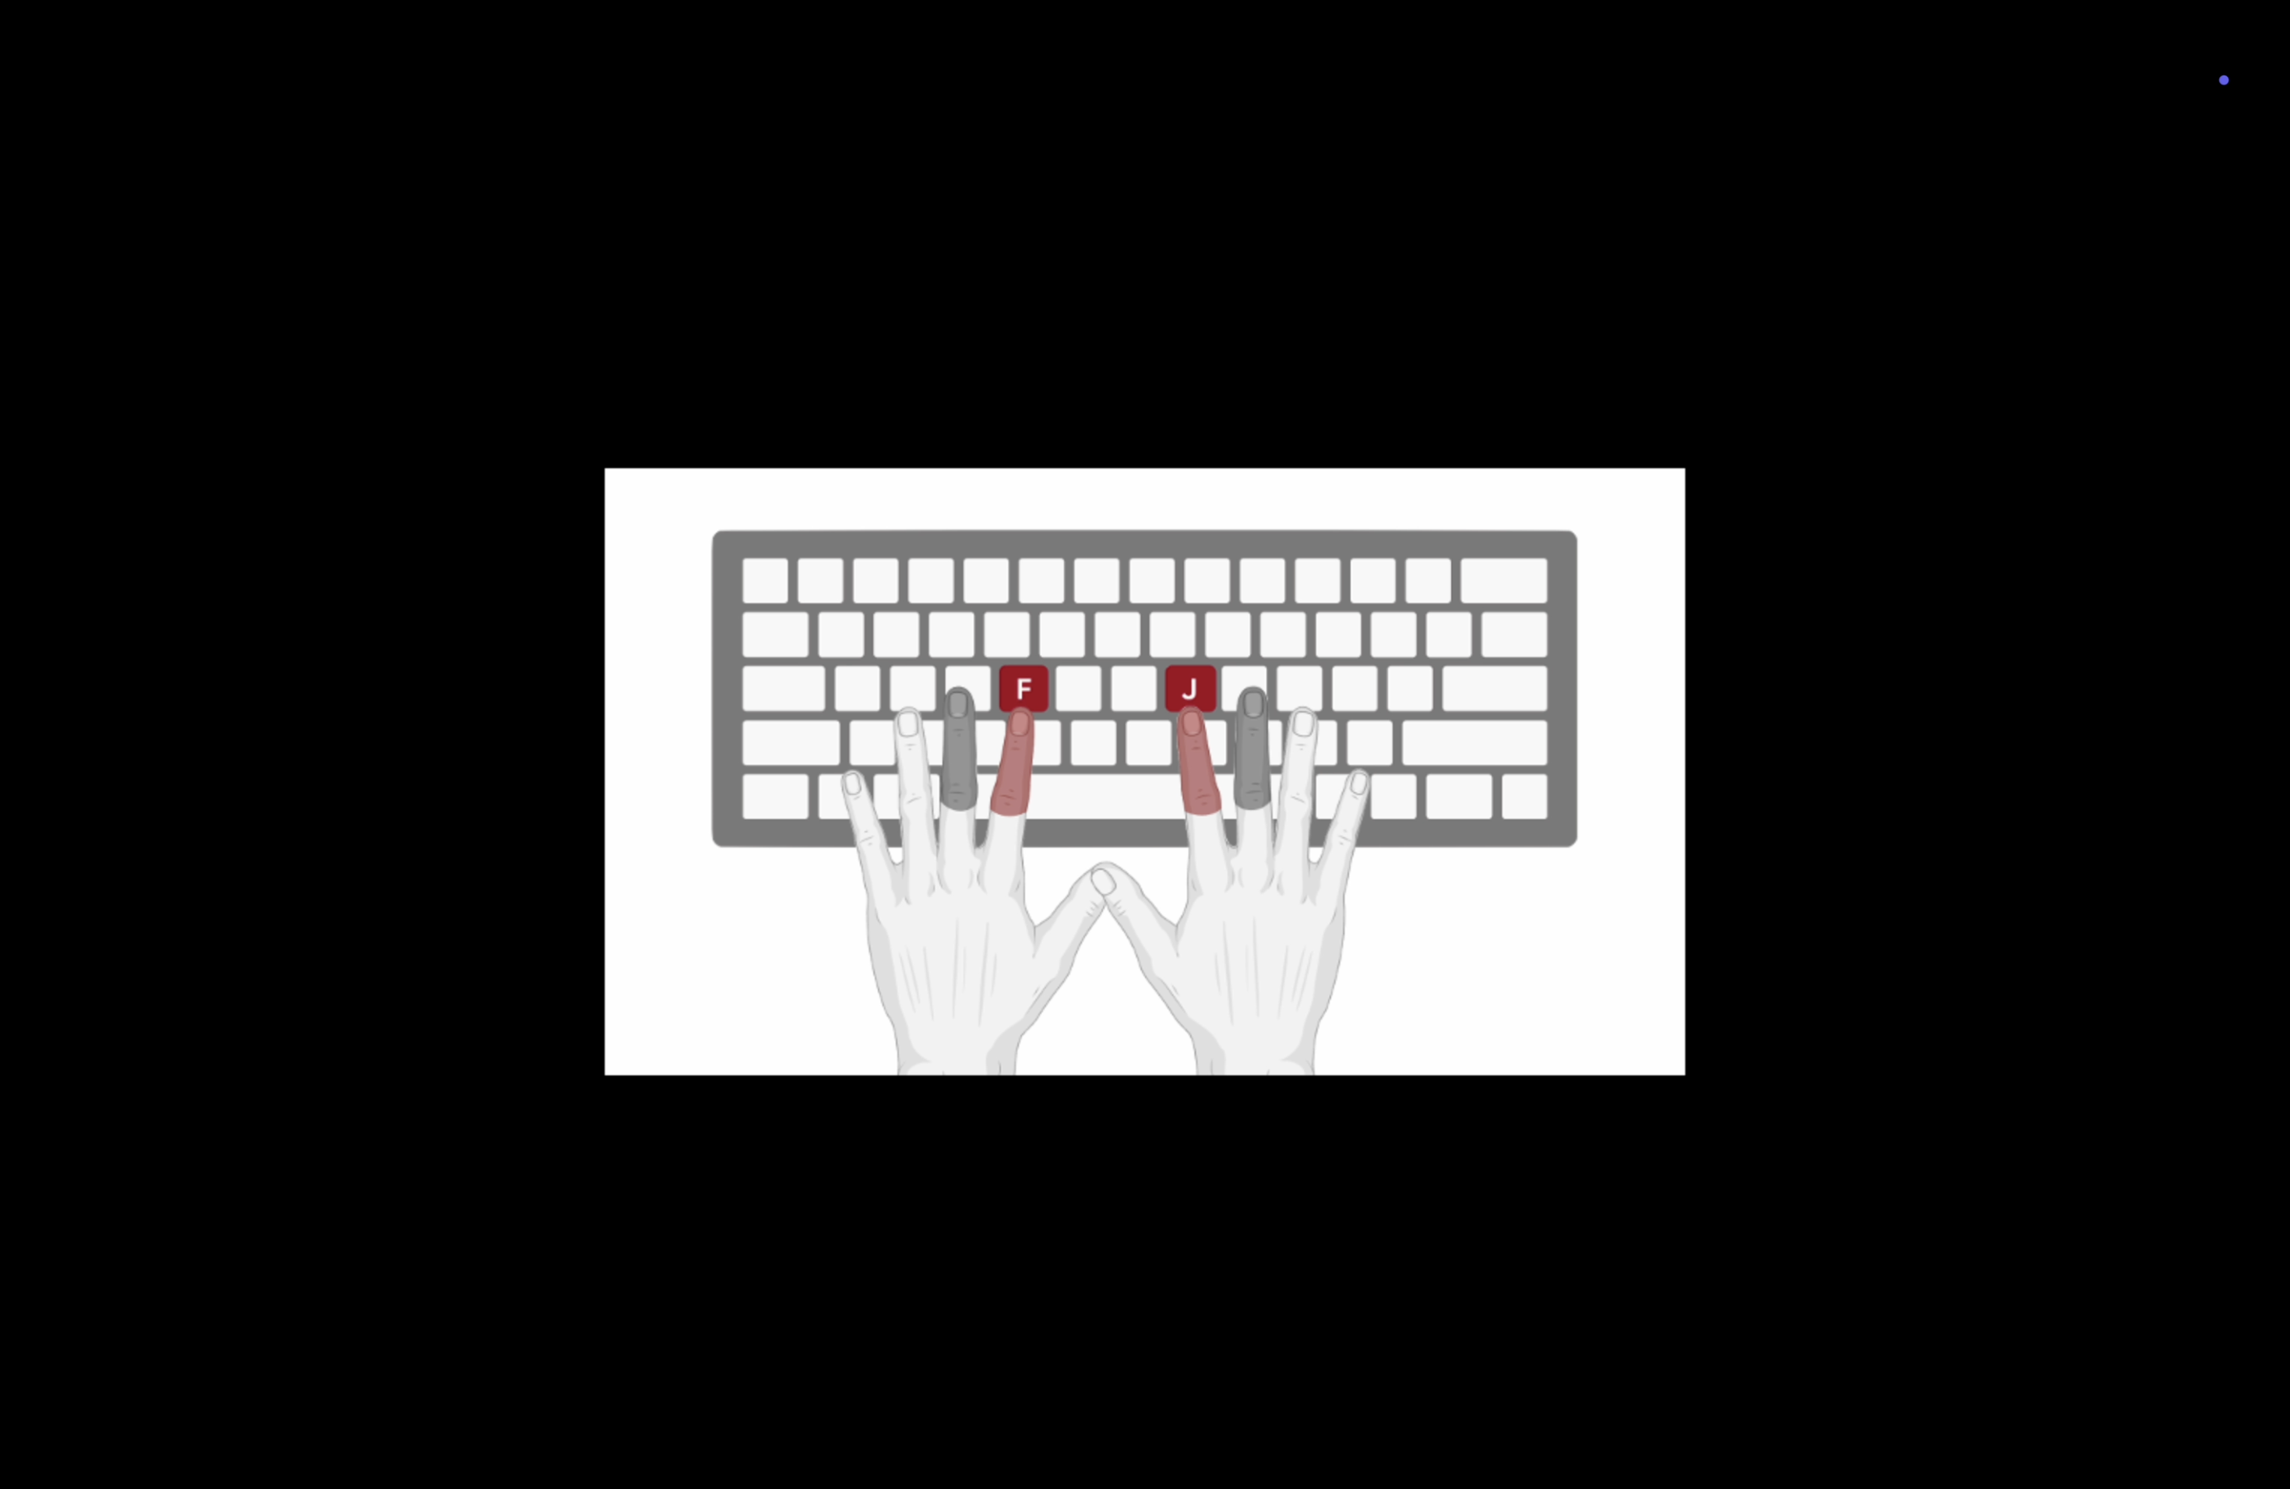





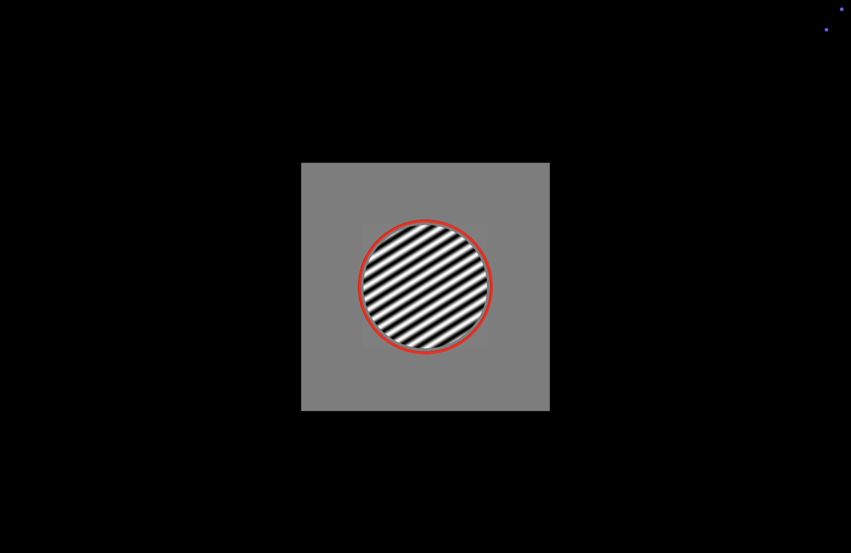


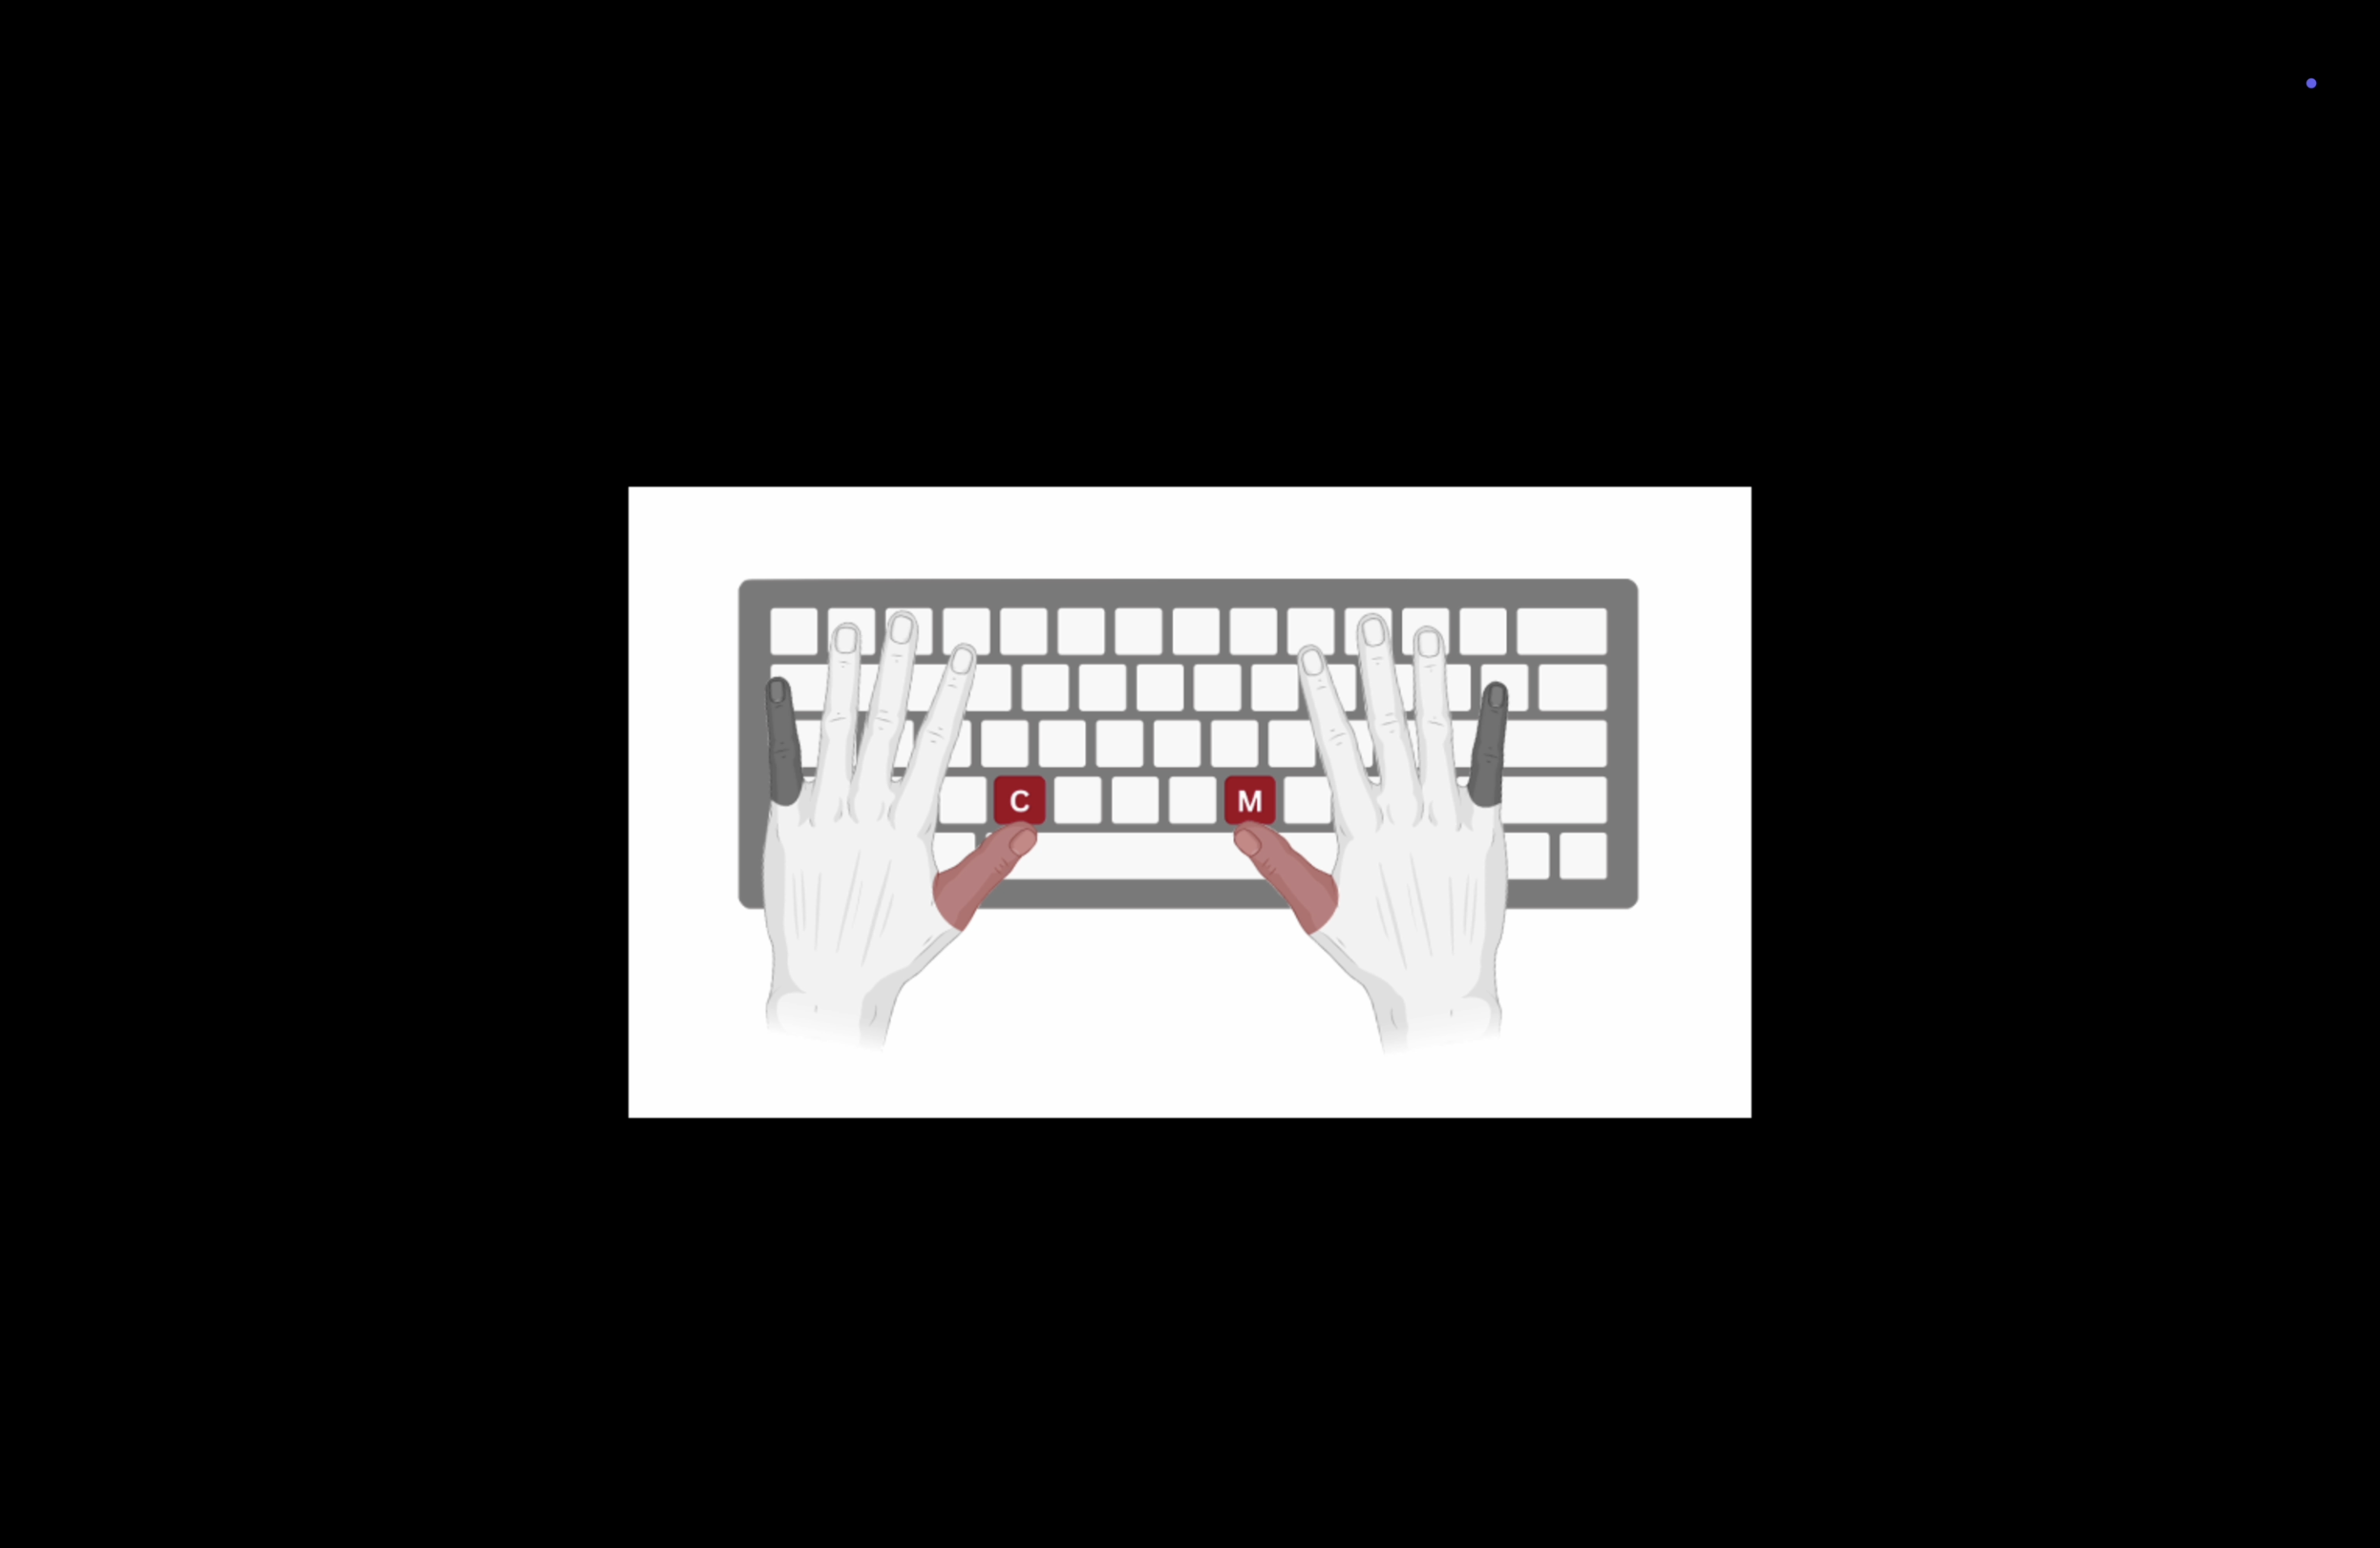
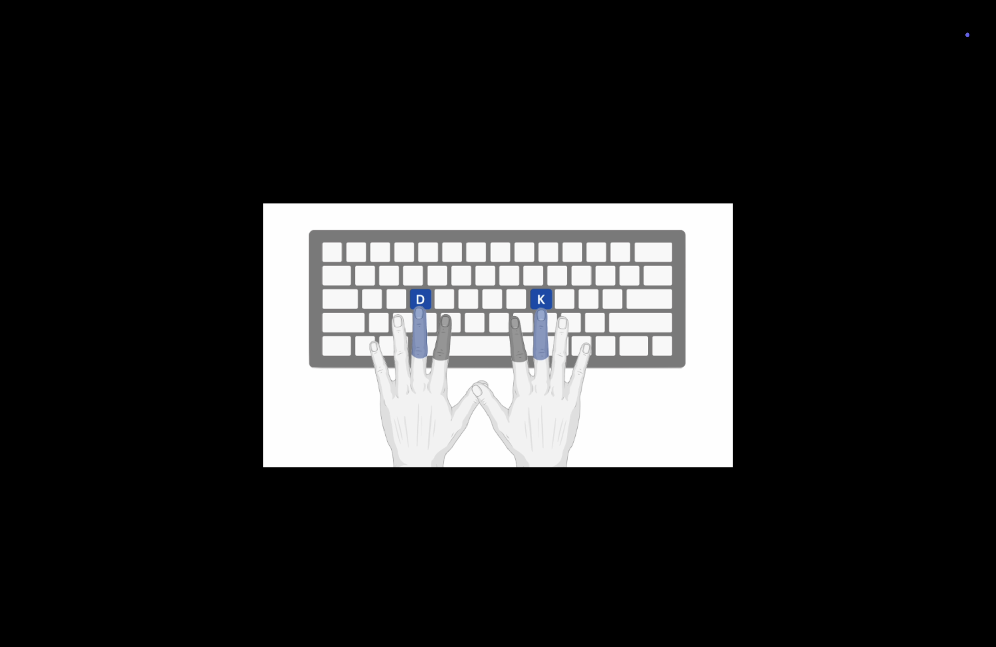
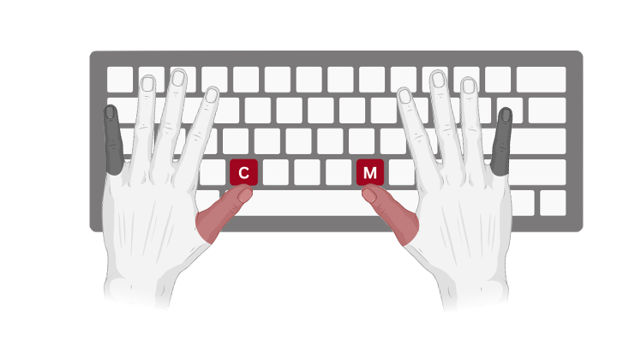
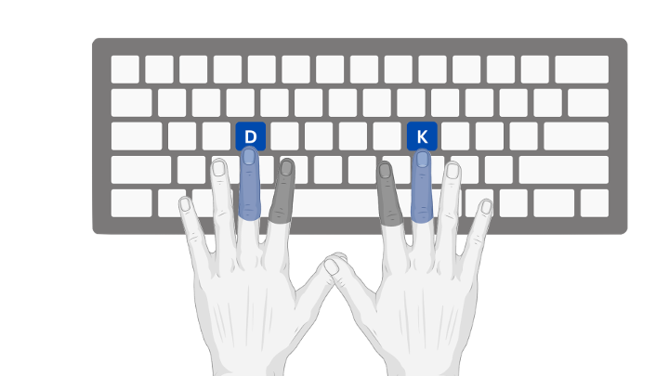
Category Learning during Task Switching
Kayla Rail¹, Saakshi Maneyalil² and Dr. Matthew Crossley²
¹ Faculty of Medicine and Health Sciences, Macquarie University, Sydney, Australia. ² School of Psychological Sciences.
INTRODUCTION
Category learning can have serious consequences (e.g. Is this berry poisonous?)
Procedural category learning is where categorisation responses are learned using trial-and-error feedback¹
Prior research has demonstrated that performance was impaired when the locations of the response keys were switched²⁻⁴
This suggests that associations are linked to motor goals (e.g., pressing a key on the right) compared to motor effectors (e.g., pressing with a specific finger)
It is unclear whether task-switching impairs how these associations are formed
RESULTS
Sample Text Column 1
PREDICTIONS
EXPERIMENTAL RESULTS
AIMS
Examine whether task switching during a procedural category learning task is driven by the formation of associations between:
Stimuli and abstract motor goals (e.g., pressing a key) or
Stimuli and concrete motor actions (e.g., pressing with a specific finger)
METHODS
Sample Text Column 1w
No difference between congruency conditions is strong evidence for concrete motor goals
However, power is low due to small sample size
+
Conducted a literature review on Category Learning and Automaticity
Information-Integration category learning task recruits procedural learning
2 x 2 design: Task switching condition (congruent vs. incongruent) and Finger distance (finger pairs which are close together vs. far apart)
Congruent: A category is assigned to the same hand across subtasks
Incongruent: A category is assigned to different hands across subtasks
8 participants in each of the 4 conditions
Pinky - Thumb
Index - Middle
=
Cue Image
DISCUSSION
Data collection was limited due to sharing the lab with other students
To reach sufficient power, 32 participants per group were required, we only had 7
Theory does not consider contra vs. ipsilateral motor cortex
Difference in motor/homunculus space between fingers might not be enough
Future research could focus on block-by-block task switching, instead of trial-by-trial
=
Stimulus
CONCLUSIONS
We found no difference between congruent and incongruent conditions
Previous findings⁵ suggested this existed at the level of motor actions, which conflicts with our current results
Feedback
Cue Image
REFERENCES
Ashby FG, Valentin VV. Multiple Systems of Perceptual Category Learning: Theory and Cognitive Tests. Elsevier; 2005. p. 547–72.
Ashby FG, Ell SW, Waldron EM. Procedural learning in perceptual categorization. Mem Cognit. 2003 Oct;31(7):1114–25.
Crossley MJ, Madsen NR, Ashby FG. Procedural learning of unstructured categories. Psychon Bull Rev. 2012 Dec;19(6):1202–9.
Spiering BJ, Ashby FG. Response processes in information–integration category learning. Neurobiol Learn Mem. 2008 Sep;90(2):330–8.
Crossley MJ, Arnold H, Kaplan DM, Ashby FG. Motor demands in catogory learning during task switching. (unpublished).
Notes:
Explanation of predictions >> need to explain the difference between index/middle // pinky/thumb

Slide 2
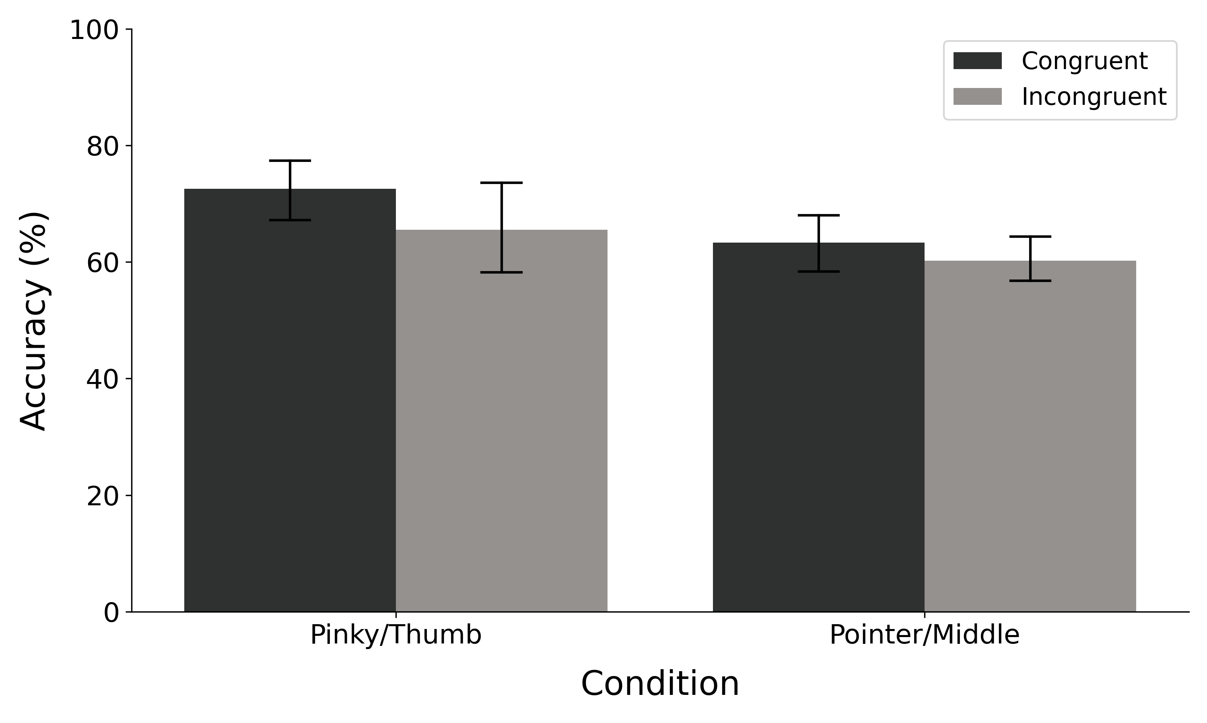
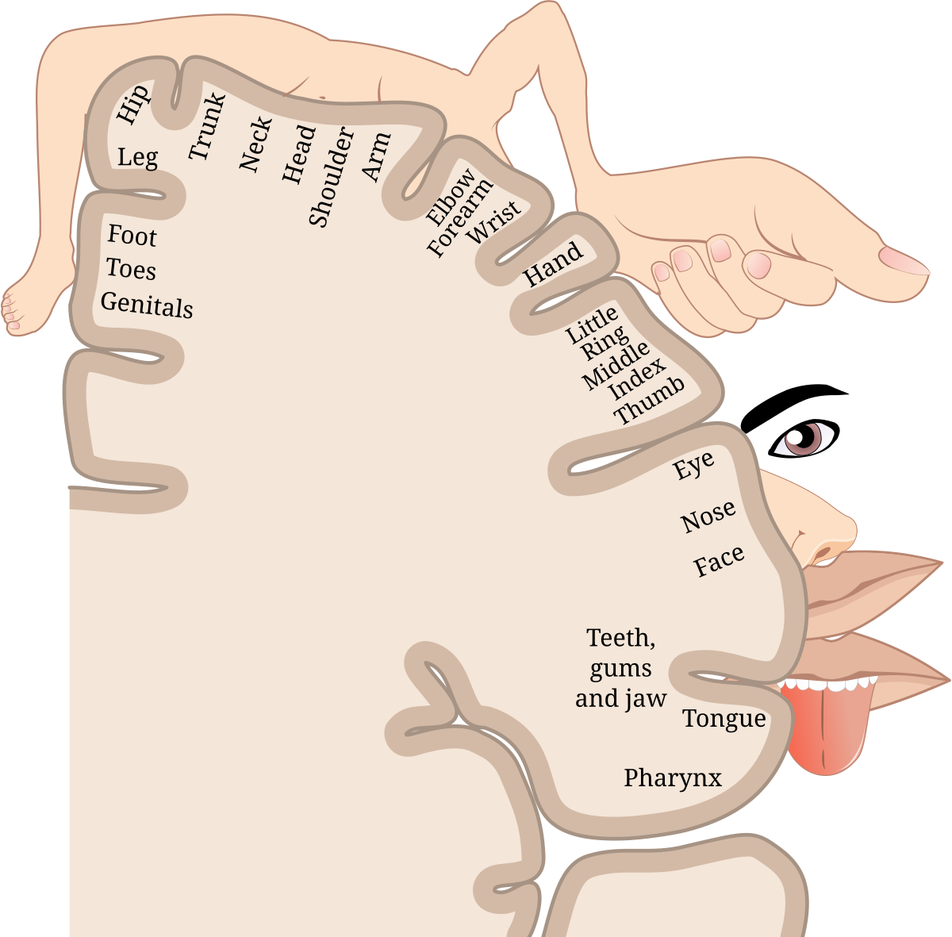
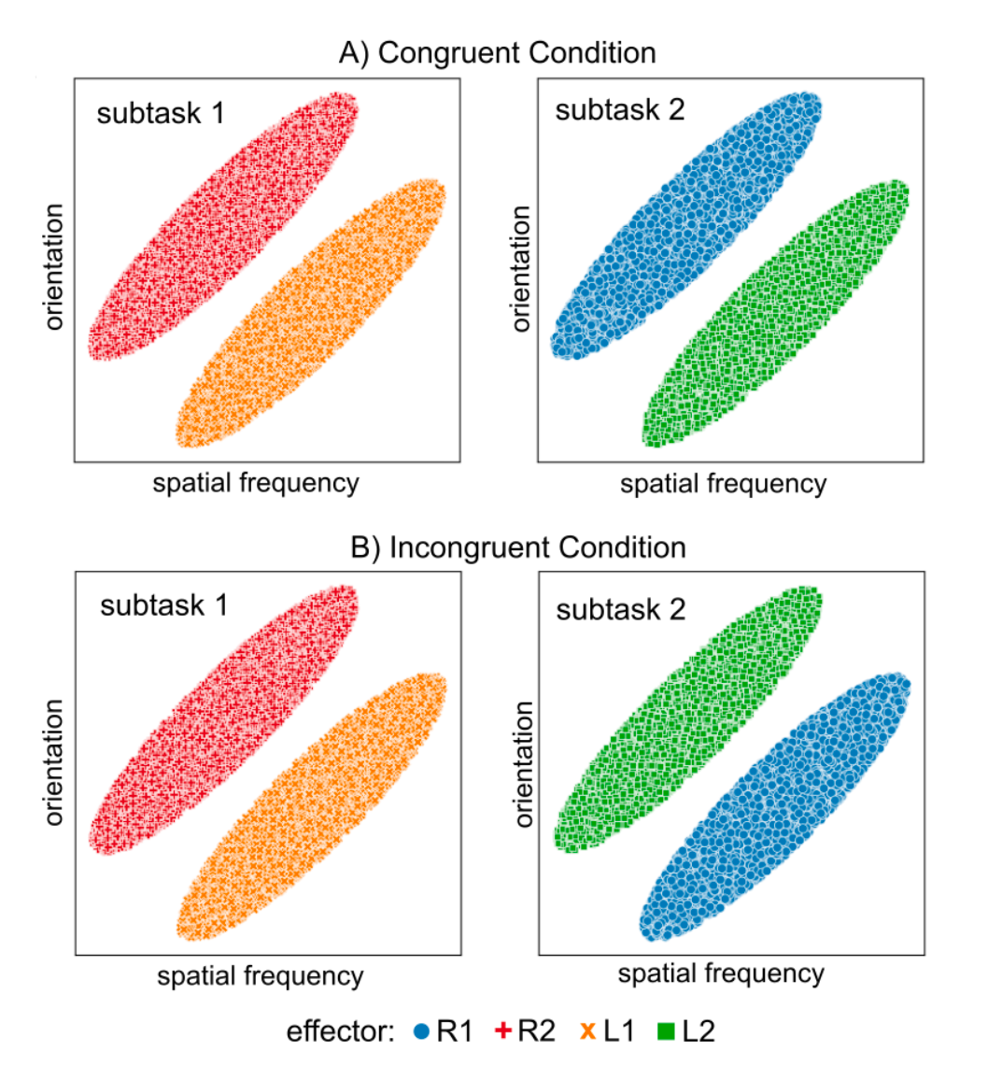
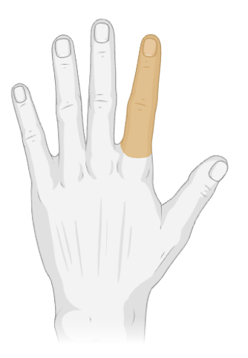
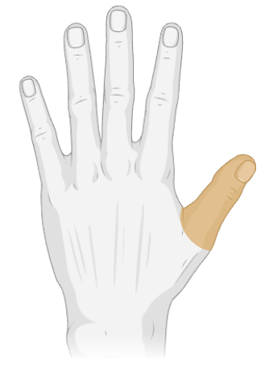
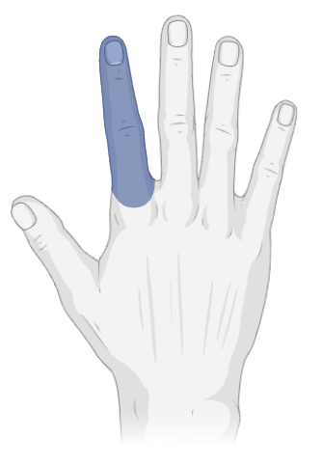
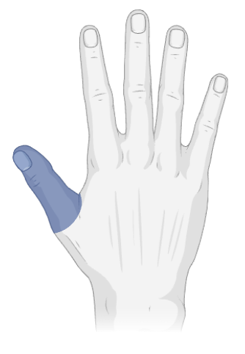
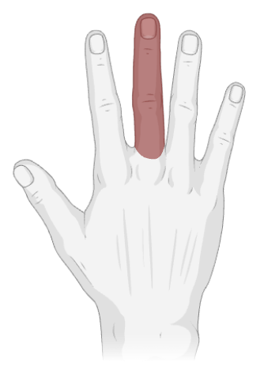
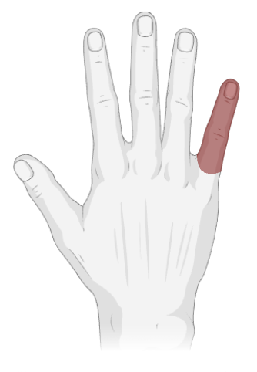
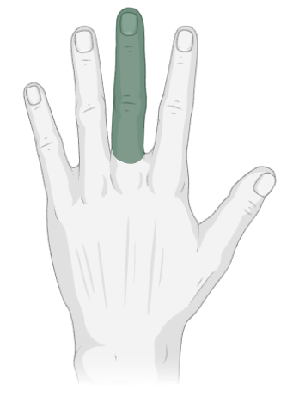
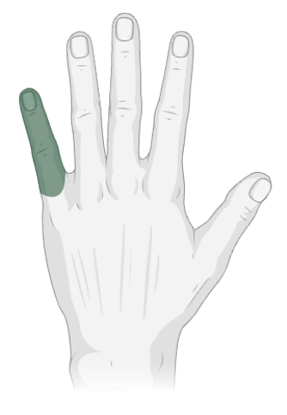
Category Learning during Task Switching
Kayla Rail¹, Saakshi Maneyalil² and Dr. Matthew Crossley²
¹ Faculty of Medicine and Health Sciences, Macquarie University, Sydney, Australia. ² School of Psychological Sciences.
INTRODUCTION
Category learning can have serious consequences (e.g. Is this berry poisonous?)
Procedural category learning is where categorisation responses are learned using trial-and-error feedback¹
Prior research has demonstrated that performance was impaired when the locations of the response keys were switched²⁻⁴
This suggests that associations are linked to motor goals (e.g., pressing a key on the right) compared to motor effectors (e.g., pressing with a specific finger)
It is unclear whether task-switching impairs how these associations are formed
RESULTS
Sample Text Column 1
AIMS
Examine whether task switching during a procedural category learning task is driven by the formation of associations between:
Stimuli and abstract motor goals (e.g., pressing a key) or
Stimuli and concrete motor actions (e.g., pressing with a specific finger)
Results
METHODS
Sample Text Column 1w
Congruent Condition
+
Subtask 1
=
Subtask 2
Pinky - Thumb
Index - Middle
Orientation
Orientation
Cue Image
DISCUSSION
Could only collect data once a week due to sharing the lab with other students
Spatial Frequency
Incongruent Condition
Spatial Frequency
Subtask 1
=
Subtask 2
Stimulus
Orientation
Orientation
Feedback
CONCLUSIONS
Findings
Sample Text Column 1
Spatial Frequency
Spatial Frequency
R2
L2
Cue Image
REFERENCES
Ashby FG, Valentin VV. Multiple Systems of Perceptual Category Learning: Theory and Cognitive Tests. Elsevier; 2005. p. 547–72.
Ashby FG, Ell SW, Waldron EM. Procedural learning in perceptual categorization. Mem Cognit. 2003 Oct;31(7):1114–25.
Crossley MJ, Madsen NR, Ashby FG. Procedural learning of unstructured categories. Psychon Bull Rev. 2012 Dec;19(6):1202–9.
Spiering BJ, Ashby FG. Response processes in information–integration category learning. Neurobiol Learn Mem. 2008 Sep;90(2):330–8.
L1
R1
Notes:
Explanation of predictions >> need to explain the difference between index/middle // pinky/thumb

Slide 3
Category Learning during Task Switching
Kayla Rail¹, Saakshi Maneyalil² and Dr. Matthew Crossley²
¹ Faculty of Medicine and Health Sciences, Macquarie University, Sydney, Australia. ² School of Psychological Sciences.
INTRODUCTION
Category learning can have serious consequences (e.g. Is this berry poisonous?)
Procedural category learning is where categorisation responses are learned using trial-and-error feedback¹
Prior research has demonstrated that performance was impaired when the locations of the response keys were switched²⁻⁴
This suggests that associations are linked to motor goals (e.g., pressing a key on the right) compared to motor effectors (e.g., pressing with a specific finger)
It is unclear whether task-switching impairs how these associations are formed
RESULTS
- Add homunculus image to help explanation
Sample Text Column 1
AIMS
Examine whether task switching during a procedural category learning task is driven by the formation of associations between:
Stimuli and abstract motor goals (e.g., pressing a key) or
Stimuli and concrete motor actions (e.g., pressing with a specific finger)
R2
L2
Sample Text Column 1w
L1
R1
=
Congruent Condition
Subtask 1
Subtask 2
Cue Image
DISCUSSION
Could only collect data once a week due to sharing the lab with other students
Orientation
Orientation
Stimulus
=
Spatial Frequency
Incongruent Condition
Spatial Frequency
Subtask 1
Subtask 2
Orientation
CONCLUSIONS
Findings
Sample Text Column 1
Feedback
Orientation
Spatial Frequency
Spatial Frequency
Cue Image
REFERENCES
Ashby FG, Valentin VV. Multiple Systems of Perceptual Category Learning: Theory and Cognitive Tests. Elsevier; 2005. p. 547–72.
Ashby FG, Ell SW, Waldron EM. Procedural learning in perceptual categorization. Mem Cognit. 2003 Oct;31(7):1114–25.
Crossley MJ, Madsen NR, Ashby FG. Procedural learning of unstructured categories. Psychon Bull Rev. 2012 Dec;19(6):1202–9.
Spiering BJ, Ashby FG. Response processes in information–integration category learning. Neurobiol Learn Mem. 2008 Sep;90(2):330–8.
Notes:
Explanation of predictions >> need to explain the difference between index/middle // pinky/thumb

Slide 4
Category Learning during Task Switching
Kayla Rail¹, Saakshi Maneyalil² and Dr. Matthew Crossley²
¹ Faculty of Medicine and Health Sciences, Macquarie University, Sydney, Australia. ² School of Psychological Sciences.
INTRODUCTION
Category learning can have serious consequences (e.g. Is this berry poisonous?)
Procedural category learning is where categorisation responses are learned using trial-and-error feedback¹
Prior research has demonstrated that performance was impaired when the locations of the response keys were switched²⁻⁴
This suggests that associations are linked to motor goals (e.g., pressing a key on the right) compared to motor effectors (e.g., pressing with a specific finger)
It is unclear whether task-switching impairs how these associations are formed
RESULTS
Sample Text Column 1
AIMS
Examine whether task switching during a procedural category learning task is driven by the formation of associations between:
Stimuli and abstract motor goals (e.g., pressing a key) or
Stimuli and concrete motor actions (e.g., pressing with a specific finger)
METHODS
Sample Text Column 1w
Congruent Condition
+
Subtask 1
=
Subtask 2
Pinky - Thumb
Index - Middle
Orientation
Orientation
Cue Image
DISCUSSION
Limitation: Could only collect data once a week due to sharing the lab with other students
Limitation: Small data set size, limited power!!!
Spatial Frequency
Incongruent Condition
Spatial Frequency
Subtask 1
=
Subtask 2
Stimulus
Orientation
Orientation
Feedback
CONCLUSIONS
Findings
Sample Text Column 1
Spatial Frequency
Spatial Frequency
R1
R2
Cue Image
REFERENCES
Ashby FG, Valentin VV. Multiple Systems of Perceptual Category Learning: Theory and Cognitive Tests. Elsevier; 2005. p. 547–72.
Ashby FG, Ell SW, Waldron EM. Procedural learning in perceptual categorization. Mem Cognit. 2003 Oct;31(7):1114–25.
Crossley MJ, Madsen NR, Ashby FG. Procedural learning of unstructured categories. Psychon Bull Rev. 2012 Dec;19(6):1202–9.
Spiering BJ, Ashby FG. Response processes in information–integration category learning. Neurobiol Learn Mem. 2008 Sep;90(2):330–8.
L1
L2

Slide 5
In the methods section, to show sufficient evidence of research, just mention that I also did a literature review but for the sake of time, it will not be covered in this presentation
REFERENCES
Ashby FG, Valentin VV. Multiple Systems of Perceptual Category Learning: Theory and Cognitive Tests. Elsevier; 2005. p. 547–72.
Ashby FG, Ell SW, Waldron EM. Procedural learning in perceptual categorization. Mem Cognit. 2003 Oct;31(7):1114–25.
Crossley MJ, Madsen NR, Ashby FG. Procedural learning of unstructured categories. Psychon Bull Rev. 2012 Dec;19(6):1202–9.
Spiering BJ, Ashby FG. Response processes in information–integration category learning. Neurobiol Learn Mem. 2008 Sep;90(2):330–8.

Slide 6
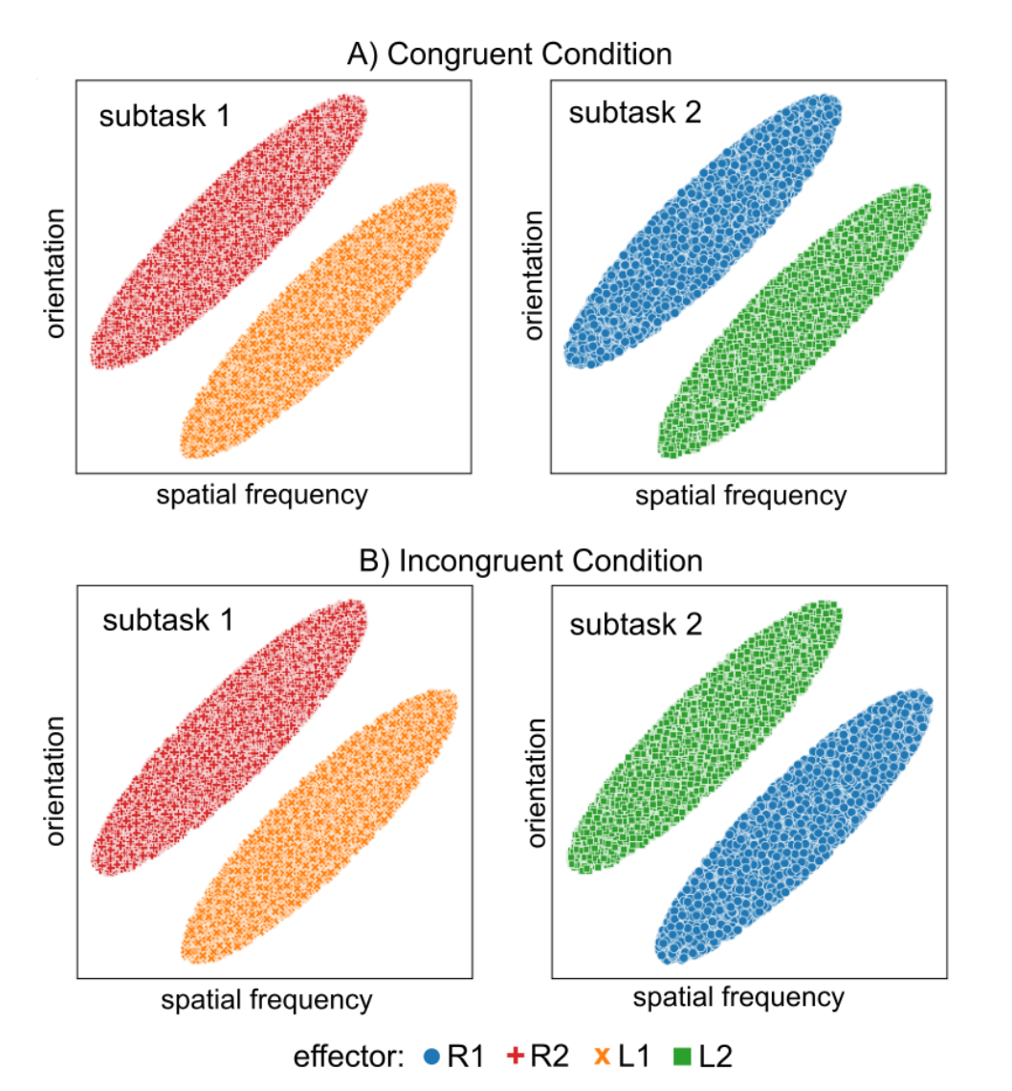
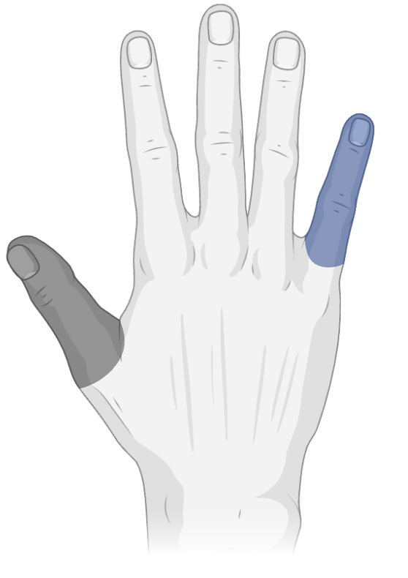
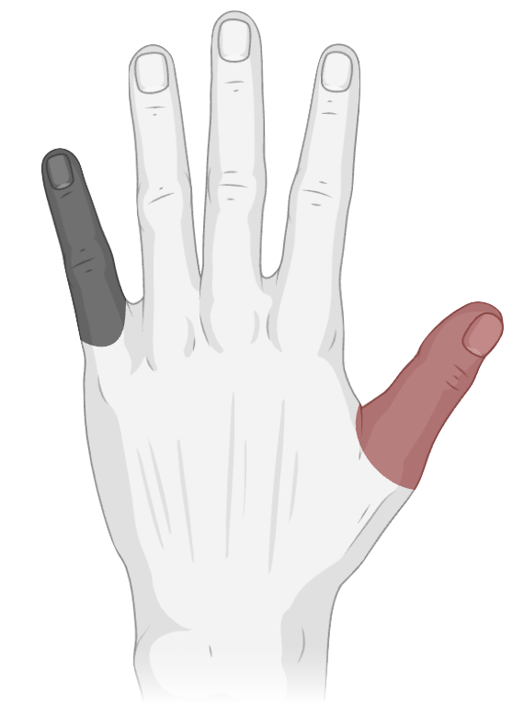
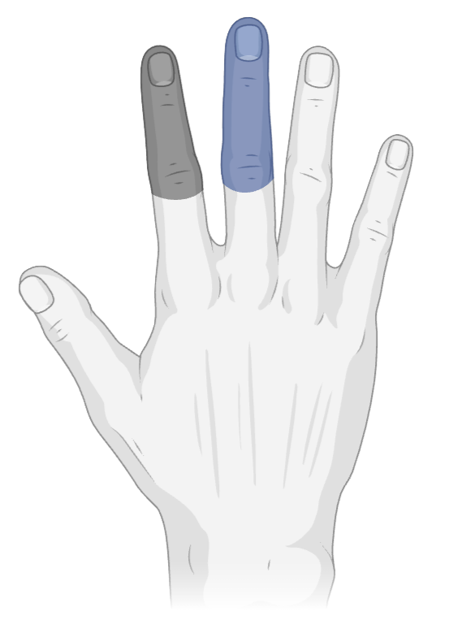
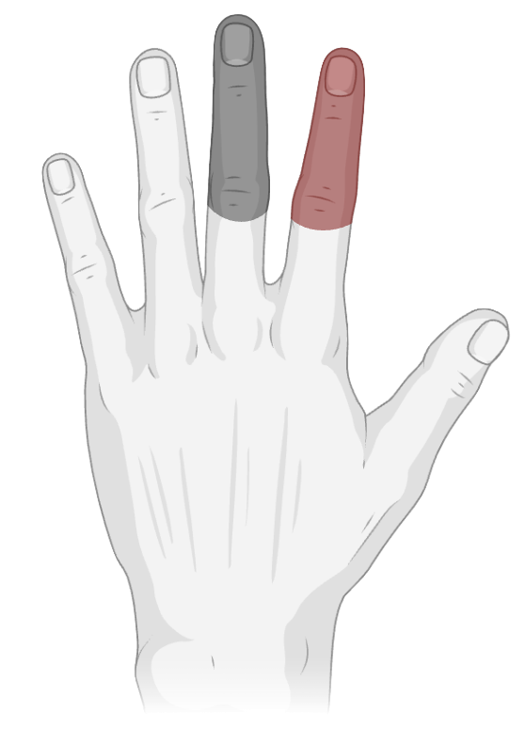
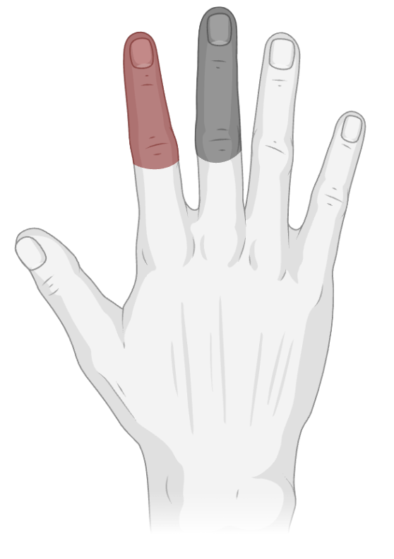
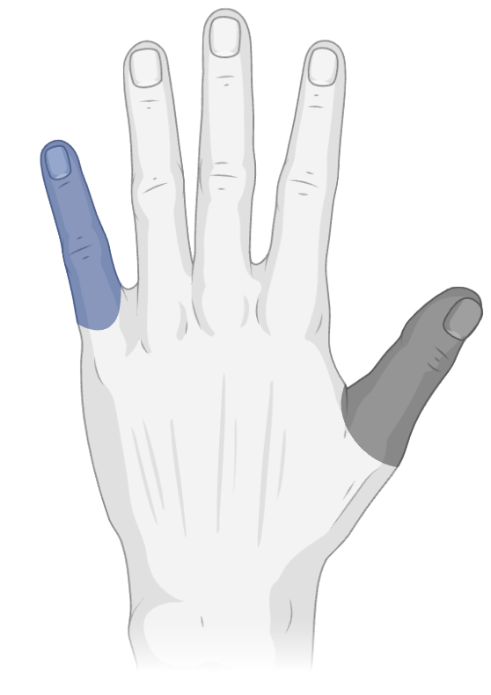
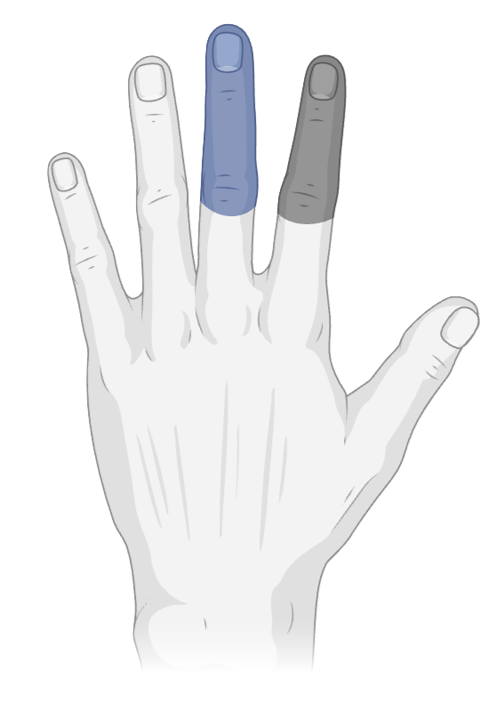
Right hand:
R1 = index
R2 = middle
R1 = thumb
R2 = pinkie
Left hand:
L1 = index
L2 = middle
L1 = thumb
L2 = pinkie
=
=

